Slide 1

Customer Shopping Behavior Analysis
Uncovering insights from transactional data to guide strategic business decisions.

Slide 2

Project Overview
Data Source
Key Goals
3,900 purchases across product categories.
Optimize operations, reduce costs, improve forecasting.
Strategic Impact
Guide business decisions, future-proof strategies.

Slide 3

Dataset Summary
Key Features
Data Snapshot
Customer demographics (Age, Gender, Location, Subscription)
Rows: 3,900
Columns: 18
Purchase details (Item, Category, Amount, Season, Size, Color)
Missing Data: 37 values in Review Rating
Shopping behavior (Discount, Promo, Previous Purchases, Frequency, Review, Shipping)

Slide 4
Exploratory Data Analysis (Python)
01
02
03
Data Loading & Initial Exploration
Missing Data Handling
Column Standardization
Imputed `Review Rating` using median by category.
Renamed to `snake_case` for readability.
Imported with `pandas`, checked structure (`df.info()`, `.describe()`).
04
05
Feature Engineering
Data Consistency & Integration
Created `age_group` and `purchase_frequency_days`.
Dropped redundant `promo_code_used`, loaded into PostgreSQL.

Slide 5
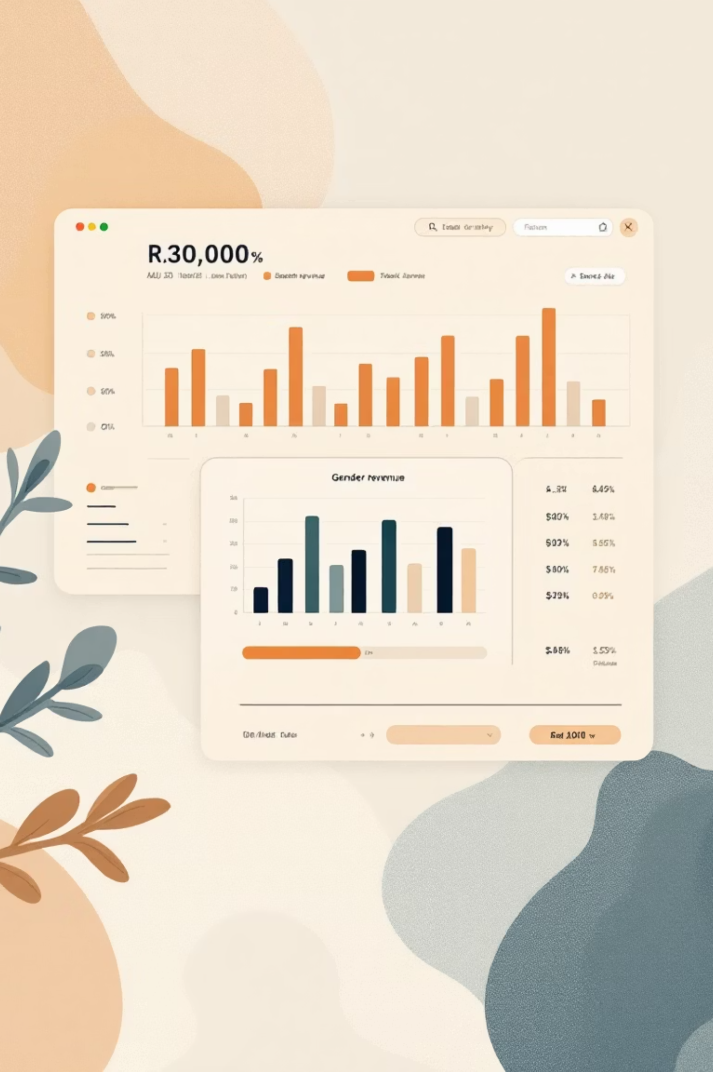
Data Analysis (SQL)
Key business questions answered through structured PostgreSQL analysis.
1
Revenue by Gender
Female: $75,191, Male: $157,890
2
High-Spending Discount Users
839 customers identified.
3
Top 5 Products by Rating
Gloves (3.86), Sandals (3.84), Boots (3.82), Hat (3.80), Skirt (3.78)
4
Shipping Type Comparison
Standard: $58.46, Express: $60.48

Slide 6

SQL Analysis: Subscribers & Products
1
2
Subscribers vs. Non-Subscribers
Discount-Dependent Products
Non-subscribers: 2847 customers, $170,436 revenue. Subscribers: 1053 customers, $62,645 revenue.
Hat (50%), Sneakers (49.66%), Coat (49.07%), Sweater (48.17%), Pants (47.37%).
3
Repeat Buyers & Subscriptions
2518 non-subscribers, 958 subscribers among repeat buyers.

Slide 7
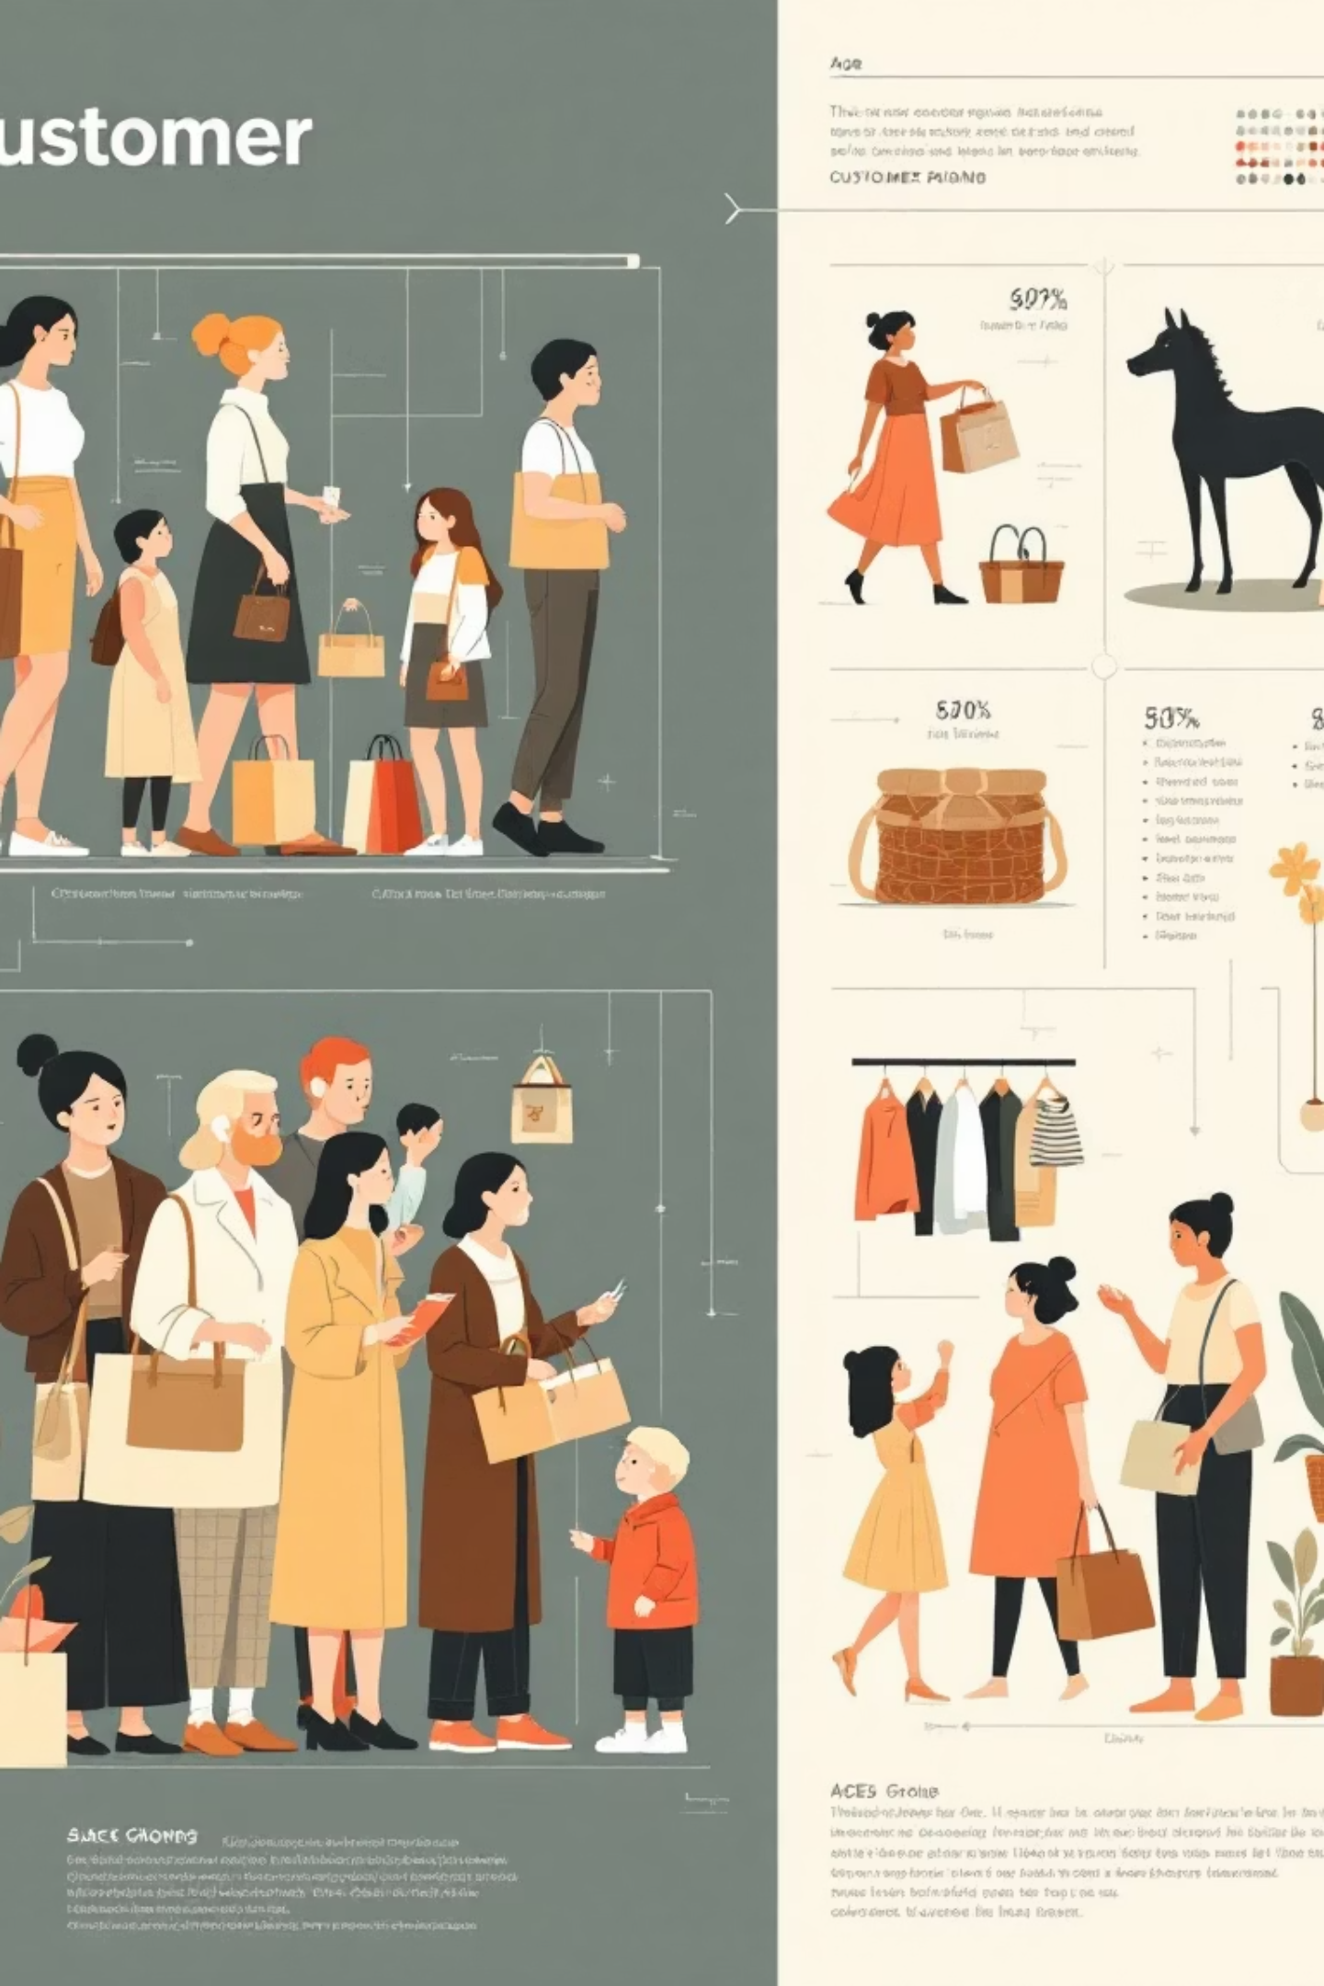
SQL Analysis: Segmentation & Revenue
Customer Segmentation
Revenue by Age Group
Loyal: 3116
Young Adult: $62,143
Returning: 701
Middle-aged: $59,197
New: 83
Adult: $55,978
Senior: $55,763

Slide 8

Top Products per Category
Accessories
Clothing
Jewelry (171), Sunglasses (161), Belt (161)
Blouse (171), Pants (171), Shirt (169)
Footwear
Outerwear
Sandals (160), Shoes (150), Sneakers (145)
Jacket (163), Coat (161)

Slide 9
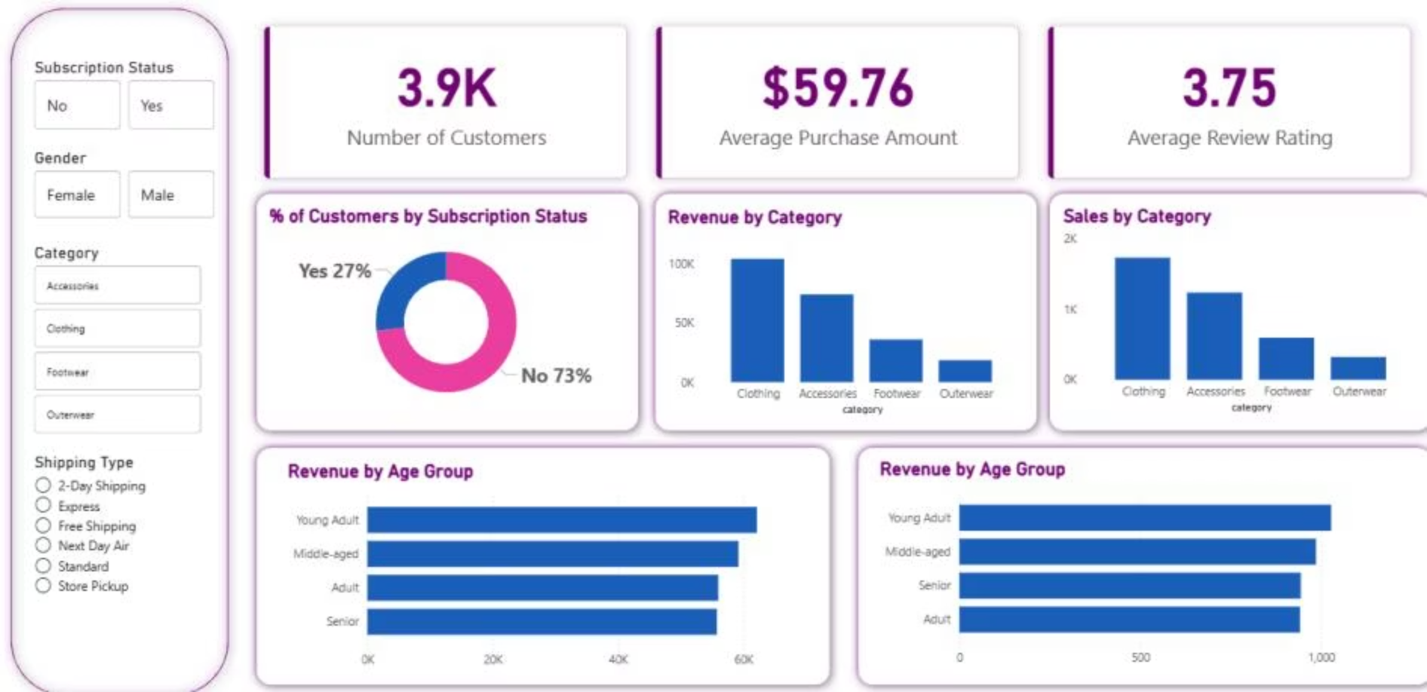


Power BI Dashboard
Interactive visualization of customer behavior insights.
27%
73%
Subscribers
Non-Subscribers

Slide 10

Business Recommendations
Boost Subscriptions
Promote exclusive benefits.
Customer Loyalty
Reward repeat buyers.
Review Discount Policy
Balance sales with margin.
Product Positioning
Highlight top-rated items.
Targeted Marketing
Focus on high-revenue groups.

